Slide 1
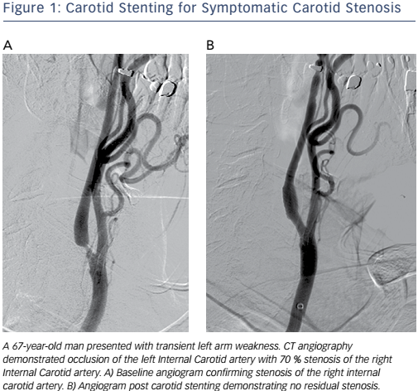
Radvany MG
Figure 1: Carotid Stenting for Symptomatic Carotid Stenosis
Citation: Interventional Cardiology Review 2017;12(1):31–5
https://doi.org/10.15420/icr.2016:23:2

