Slide 1
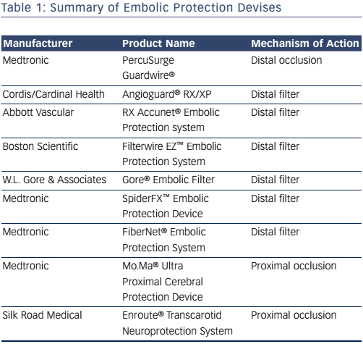
Radvany MG
Table 1: Summary of Embolic Protection Devises
Citation: Interventional Cardiology Review 2017;12(1):31–5
https://doi.org/10.15420/icr.2016:23:2

