Slide 1
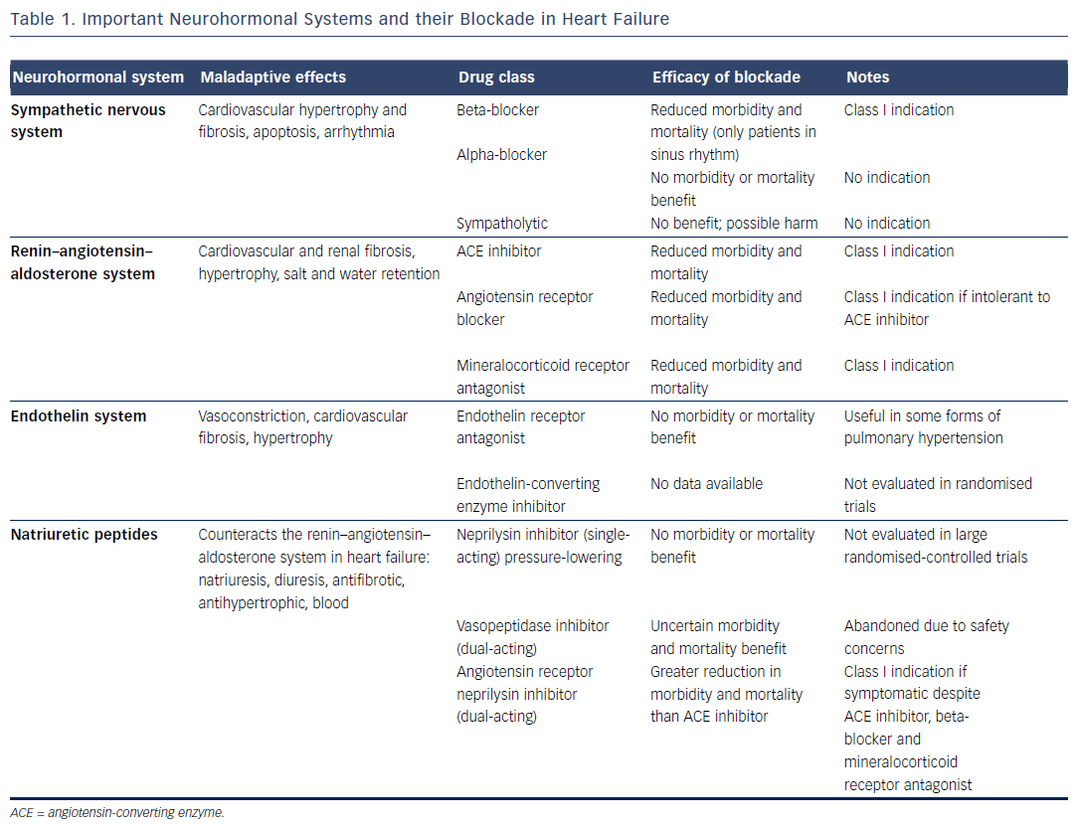
von Lueder TG, Kotecha D, Atar D, Hopper I
Table 1. Important Neurohormonal Systems and their Blockade in Heart Failure
Citation: Cardiac Failure Review 2017;3(1):19–24.
https://doi.org/10.15420/cfr.2016:22:2

