Slide 1
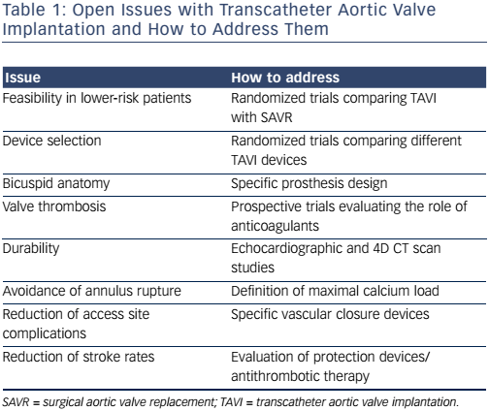
O'Sullivan CJ, Wenaweser P
Table 1: Open Issues with Transcatheter Aortic Valve Implantation and How to Address Them
Citation: Interventional Cardiology Review 2017;12(1):44–50
https://doi.org/10.15420/icr.2016:24:2

