Slide 1
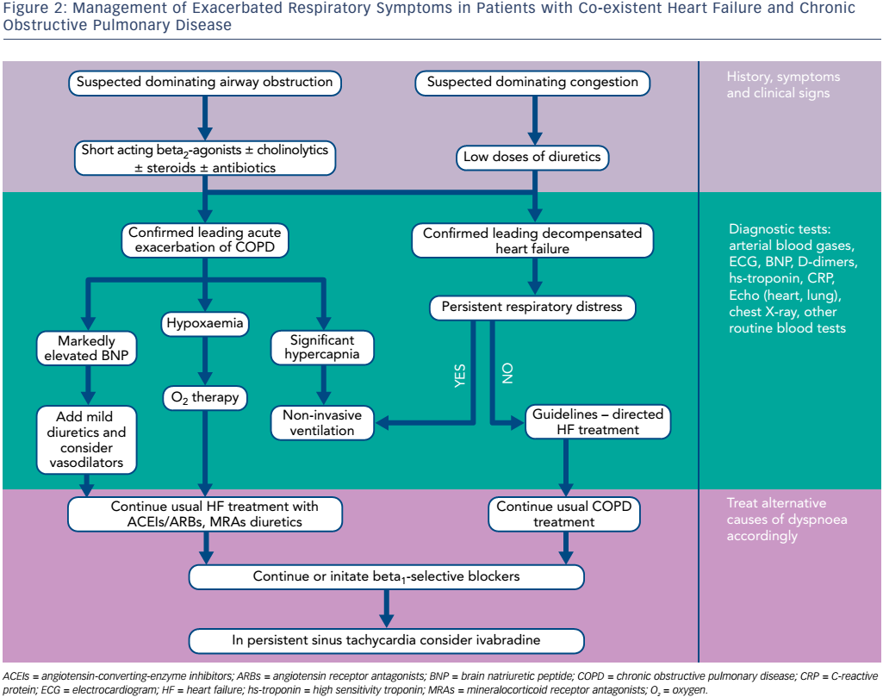
Celutkiene J, Balčiūnas M, Kablučko D, Vaitkevičiūtė L, Blaščiuk J, Danila E
Figure 2: Management of Exacerbated Respiratory Symptoms in Patients with Co-existent Heart Failure and Chronic Obstructive Pulmonary Disease
Citation: Cardiac Failure Review 3(1):56–61.
https://doi.org/10.15420/cfr.2016:23:2

