Slide 1
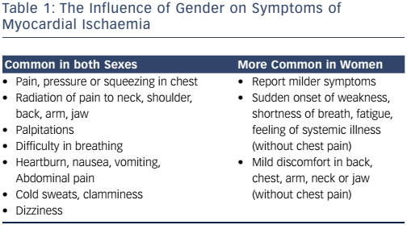
Keteepe-Arachi T, Sharma S
Table 1: The Influence of Gender on Symptoms of Myocardial Ischaemia
Citation: European Cardiology Review 2017;12(1):10–3
https://doi.org/10.15420/ecr.2016:32:1

