Slide 1
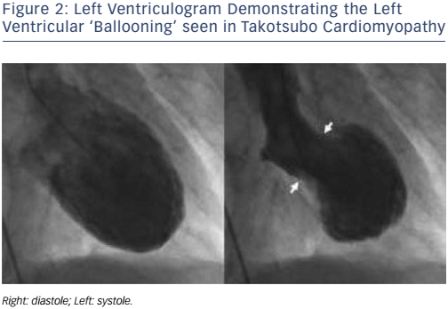
Keteepe-Arachi T, Sharma S
Figure 2: Left Ventriculogram Demonstrating the Left Ventricular ‘Ballooning’ seen in Takotsubo Cardiomyopathy
Citation: European Cardiology Review 2017;12(1):10–3
https://doi.org/10.15420/ecr.2016:32:1

