Slide 1
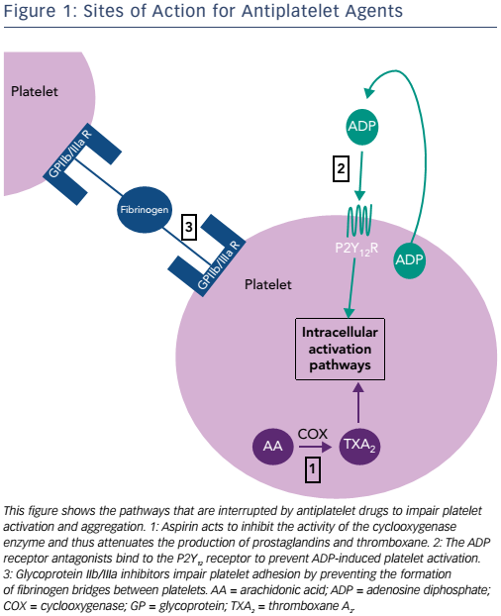
Layne K, Ferro A
Figure 1: Sites of Action for Antiplatelet Agents
Citation: European Cardiology Review 2017;12(1):33–7.
https://doi.org/10.15420/ecr.2016:34:2

