Slide 1
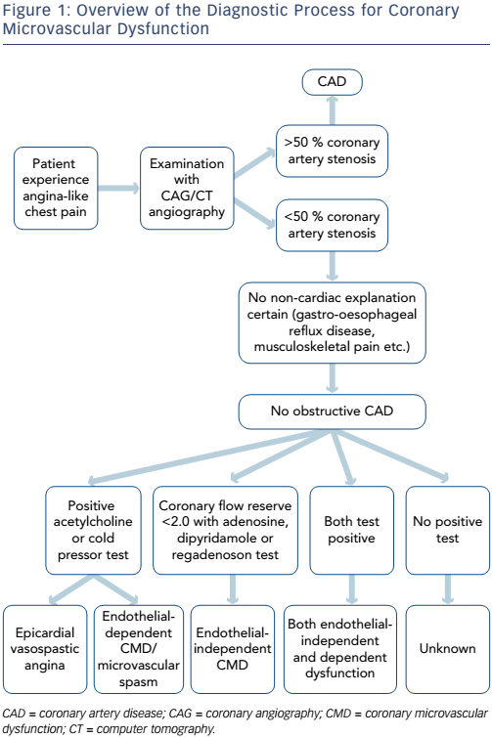
Michelsen MM, Mygind ND, Frestad D, Prescott E
Figure 1: Overview of the Diagnostic Process for Coronary Microvascular Dysfunction
Citation: European Cardiology Review 2017;12(1):14–9
https://doi.org/10.15420/ecr.2016:33:2

