Slide 1
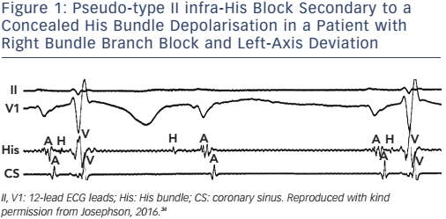
Josephson ME
Figure 1: Pseudo-type II infra-His Block Secondary to a Concealed His Bundle Depolarisation in a Patient with Right Bundle Branch Block and Left-Axis Deviation
Citation: Arrhythmia & Electrophysiology Review 2017;6(1):24–8.
https://doi.org/10.15420/aer.2016:34:2

