Slide 1
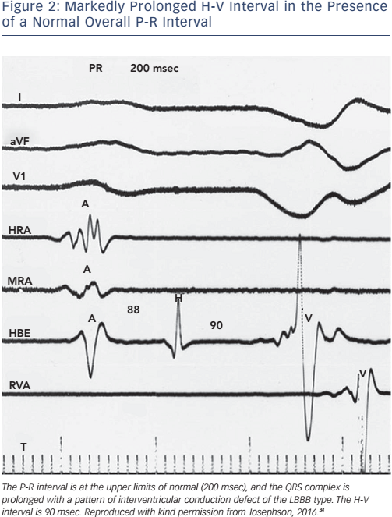
Josephson ME
Figure 2: Markedly Prolonged H-V Interval in the Presence of a Normal Overall P-R Interval
Citation: Arrhythmia & Electrophysiology Review 2017;6(1):24–8.
https://doi.org/10.15420/aer.2016:34:2

