Slide 1
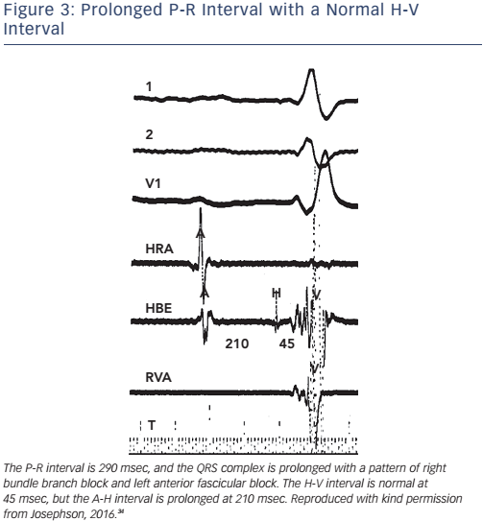
Josephson ME
Figure 3: Prolonged P-R Interval with a Normal H-V Interval
Citation: Arrhythmia & Electrophysiology Review 2017;6(1):24–8.
https://doi.org/10.15420/aer.2016:34:2

