Slide 1
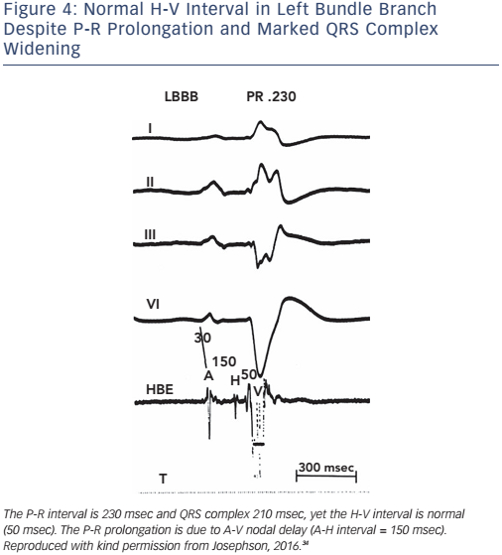
Josephson ME
Figure 4: Normal H-V Interval in Left Bundle Branch Despite P-R Prolongation and Marked QRS Complex Widening
Citation: Arrhythmia & Electrophysiology Review 2017;6(1):24–8.
https://doi.org/10.15420/aer.2016:34:2

