Slide 1

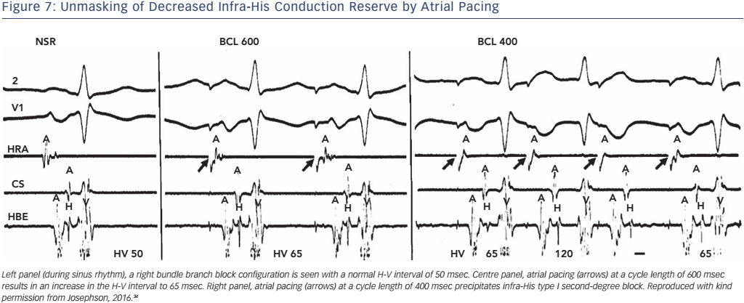
Josephson ME
Figure 7: Unmasking of Decreased Infra-His Conduction Reserve by Atrial Pacing
Citation: Arrhythmia & Electrophysiology Review 2017;6(1):24–8.
https://doi.org/10.15420/aer.2016:34:2

