Slide 1
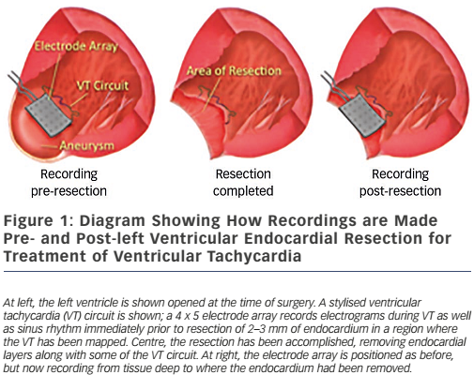
Miller JM
Figure 1: Diagram Showing How Recordings are Made Pre- and Post-left Ventricular Endocardial Resection for Treatment of Ventricular Tachycardia
Citation: Arrhythmia & Electrophysiology Review 2017;6(1):9-12.
https://doi.org/10.15420/aer.2017.6.1:ED3

