Slide 1
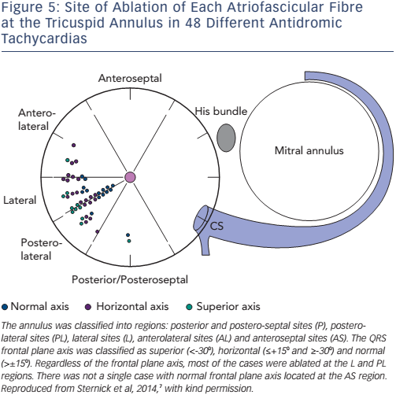
Katritsis DG, Wellens HJ, Josephson ME
Figure 5: Site of Ablation of Each Atriofascicular Fibre at the Tricuspid Annulus in 48 Different Antidromic Tachycardias
Citation: Arrhythmia & Electrophysiology Review 2017;6(1):29–32.
https://doi.org/10.15420/aer.2016:35:1

