Slide 1
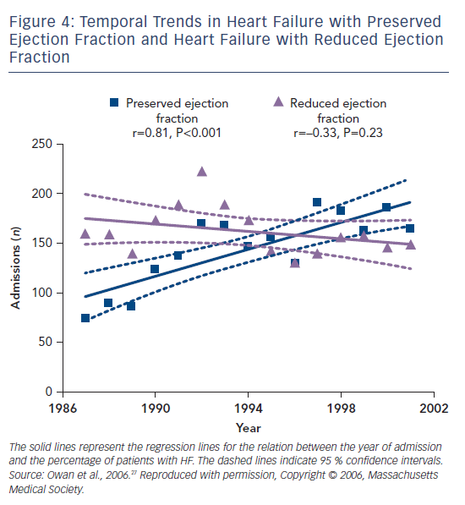
Savarese G, Lund LH
Figure 4: Temporal Trends in Heart Failure with Preserved Ejection Fraction and Heart Failure with Reduced Ejection Fraction
Citation: Cardiac Failure Review 2017;3(1):7–11.
https://doi.org/10.15420/cfr.2016:25:2

