Slide 1
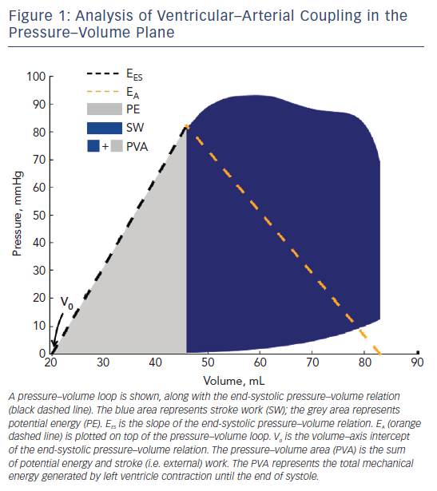
Chirinos JA, Sweitzer N
Figure 1: Analysis of Ventricular–Arterial Coupling in the Pressure–Volume Plane
Citation: Cardiac Failure Review 2017;3(1):12–8.
https://doi.org/10.15420/cfr.2017:4:2

