Slide 1
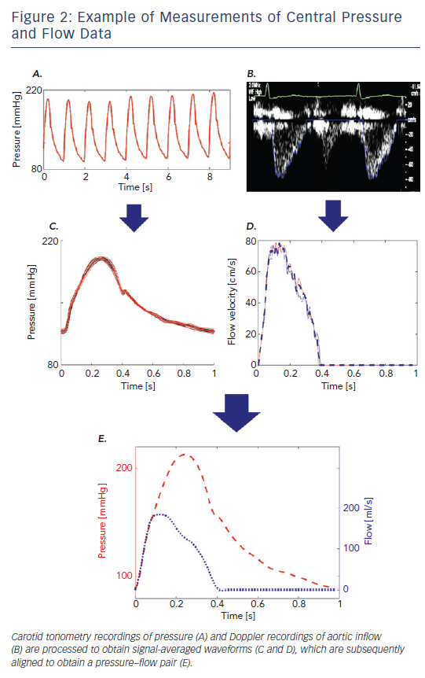
Chirinos JA, Sweitzer N
Figure 2: Example of Measurements of Central Pressure and Flow Data
Citation: Cardiac Failure Review 2017;3(1):12–8.
https://doi.org/10.15420/cfr.2017:4:2

