Slide 1

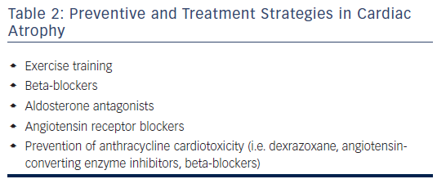
Sweeney M, Yiu A, Lyon A
Table 2: Preventive and Treatment Strategies in Cardiac Atrophy
Citation: Cardiac Failure Review 2017;3(1):62–5
https://doi.org/10.15420/cfr.2017:3:2

