Slide 1
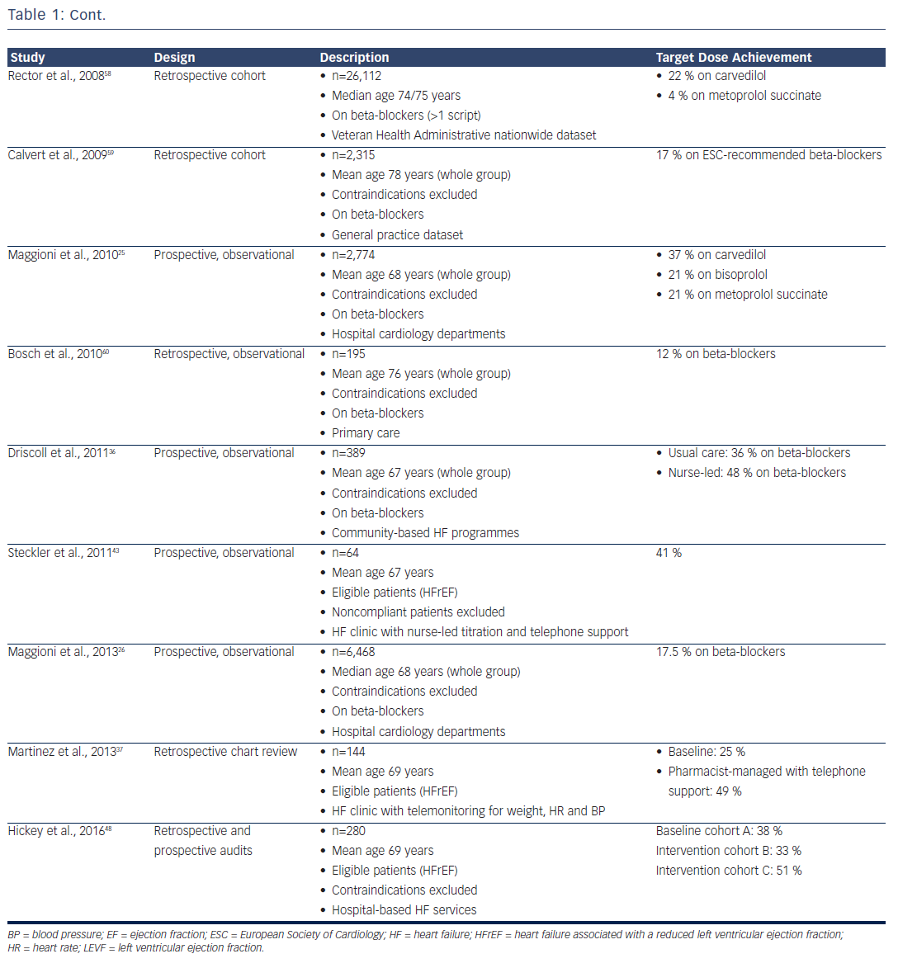
Atherton JJ, Hickey A
Table 1: Cont.
Citation: Cardiac Failure Review 2017;3(1):25–32.
https://doi.org/10.15420/cfr.2017:1:2

