Slide 1
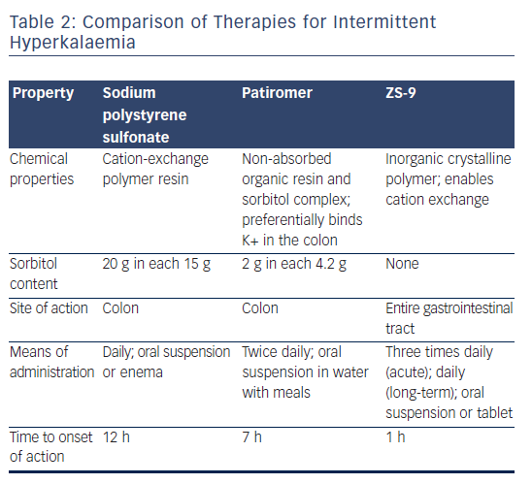
Lainscak M
Table 2: Comparison of Therapies for Intermittent Hyperkalaemia
Citation: Cardiac Failure Review 2017;3(1):33–9
https://doi.org/10.15420/cfr.2017.2.1

