Slide 1
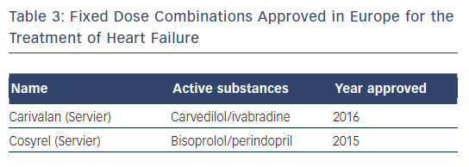
Iellamo F, Werdan K, Narkiewicz K, Rosano G, Volterrani M
Table 3: Fixed Dose Combinations Approved in Europe for the Treatment of Heart Failure
Citation: Cardiac Failure Review 2017;3(1):40–5.
https://doi.org/10.15420/cfr.2017:5:1

