Slide 1
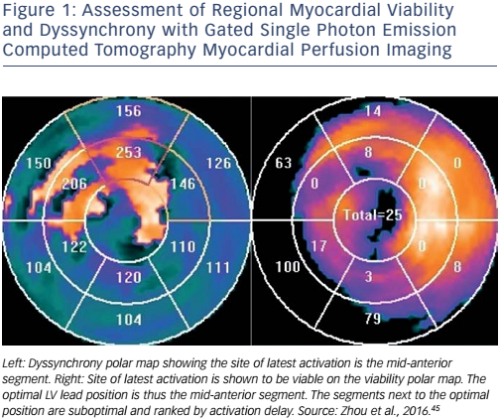
Tang H, Tang S, Zhou W
Figure 1: Assessment of Regional Myocardial Viability and Dyssynchrony with Gated Single Photon Emission Computed Tomography Myocardial Perfusion Imaging
Citation: Arrhythmia & Electrophysiology Review 2017;6(2):69–74.
https://doi.org/10.15420/aer.2016:32:2

