Slide 1
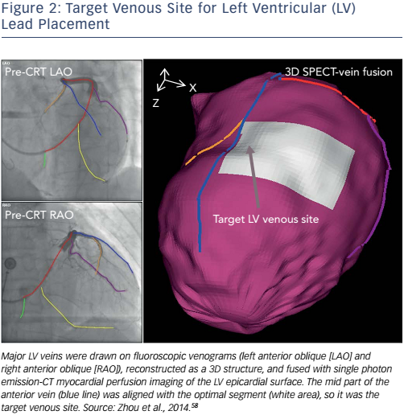
Tang H, Tang S, Zhou W
Figure 2: Target Venous Site for Left Ventricular (LV) Lead Placement
Citation: Arrhythmia & Electrophysiology Review 2017;6(2):69–74.
https://doi.org/10.15420/aer.2016:32:2

