Slide 1
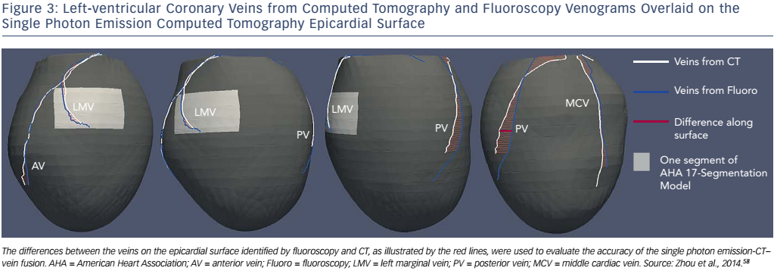
Tang H, Tang S, Zhou W
Figure 3: Left-ventricular Coronary Veins from Computed Tomography and Fluoroscopy Venograms Overlaid on the Single Photon Emission Computed Tomography Epicardial Surface
Citation: Arrhythmia & Electrophysiology Review 2017;6(2):69–74.
https://doi.org/10.15420/aer.2016:32:2

