Slide 1
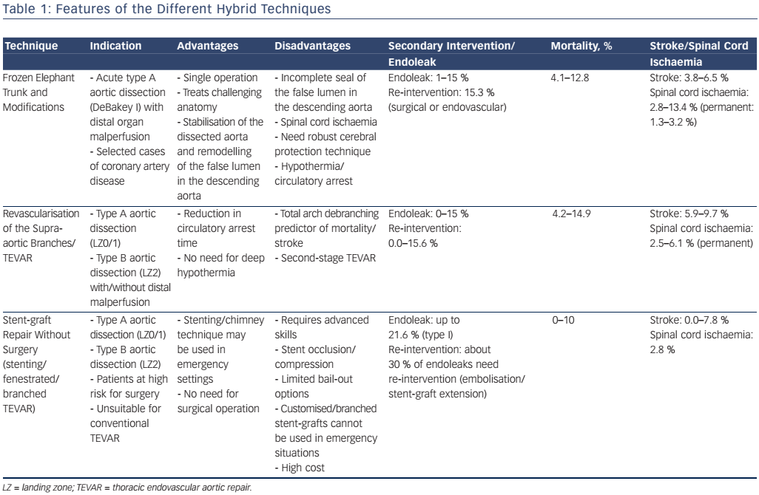
Cannavale A, Santoni M, Fanelli F, O’Sullivan G
Table 1: Features of the Different Hybrid Techniques
Citation: Interventional Cardiology Review 2017;12(1):56–60
https://doi.org/10.15420/icr.2016:16:3

