Slide 1
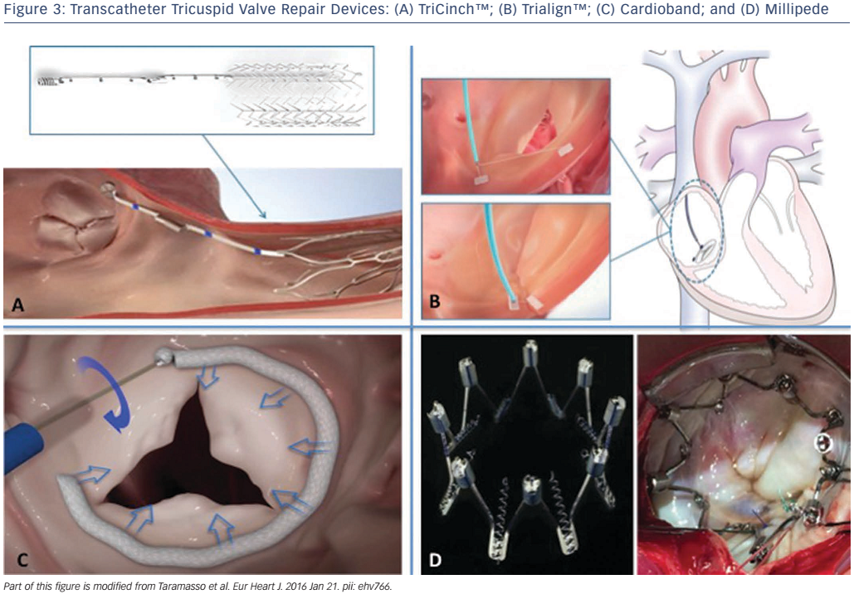
Taramasso M, Calen C, Guidotti A, Kuwata S, Rodriguez Cetina Biefer H, Nietlispach F, Zuber M, Maisano F
Figure 3: Transcatheter Tricuspid Valve Repair Devices: (A) TriCinch™; (B) Trialign™; (C) Cardioband; and (D) Millipede
Citation: Interventional Cardiology Review 2017;12(1):51–5
https://doi.org/10.15420/icr.2017:3:2

