Slide 1
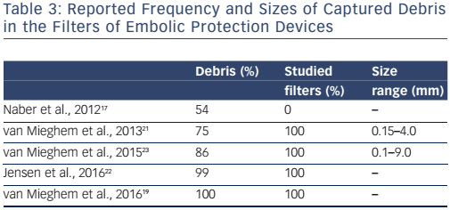
Kroon HG, Van Mieghem NM
Table 3: Reported Frequency and Sizes of Captured Debris in the Filters of Embolic Protection Devices
Citation: Interventional Cardiology Review 2017;12(1):36–9
https://doi.org/10.15420/icr.2016:30:2

