Slide 1
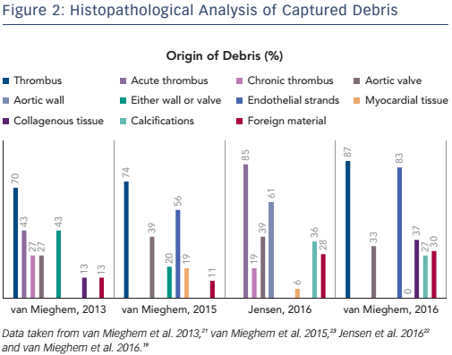
Kroon HG, Van Mieghem NM
Figure 2: Histopathological Analysis of Captured Debris
Citation: Interventional Cardiology Review 2017;12(1):36–9
https://doi.org/10.15420/icr.2016:30:2

