Slide 1
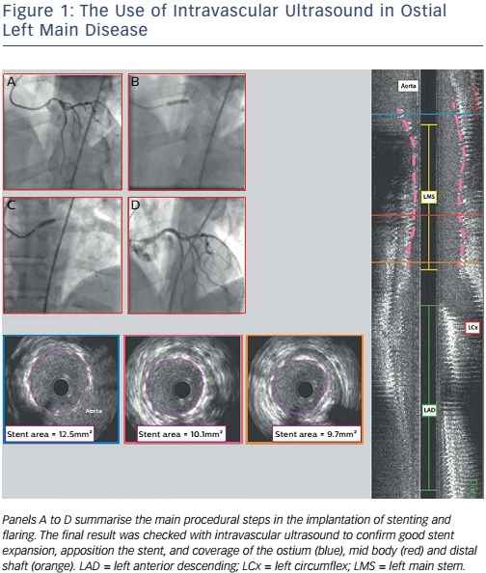
De Maria GL, Banning AP
Figure 1: The Use of Intravascular Ultrasound in Ostial Left Main Disease
Citation: Interventional Cardiology Review 2017;12(1):8–12
https://doi.org/10.15420/icr.2017:1:3

