Slide 1
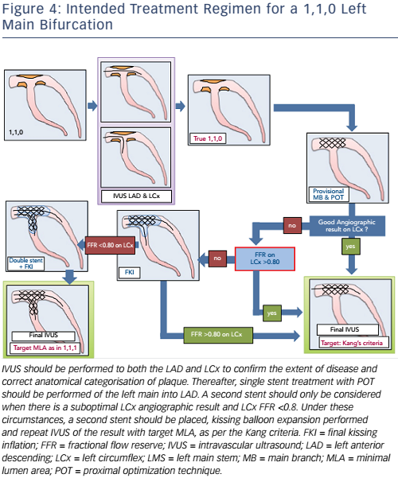
De Maria GL, Banning AP
Figure 4: Intended Treatment Regimen for a 1,1,0 Left Main Bifurcation
Citation: Interventional Cardiology Review 2017;12(1):8–12
https://doi.org/10.15420/icr.2017:1:3

