Slide 1
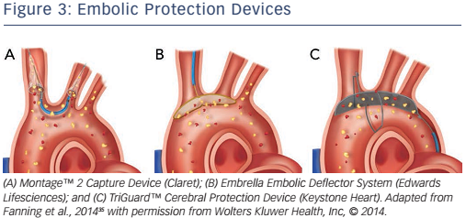
Hecker F, Arsalan M, Walther T
Figure 3: Embolic Protection Devices
Citation: Interventional Cardiology Review 2017;12(1):25–30
https://doi.org/10.15420/icr.2016:26:1

