Slide 1
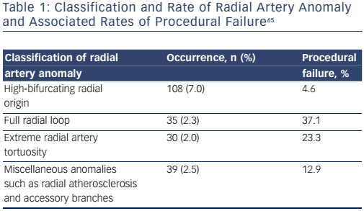
Sandhu K, Butler R, Nolan J
Table 1: Classification and Rate of Radial Artery Anomaly and Associated Rates of Procedural Failure65
Citation: Interventional Cardiology Review 2017;12(1):18–24
https://doi.org/10.15420/icr.2017:2:2

