Slide 1
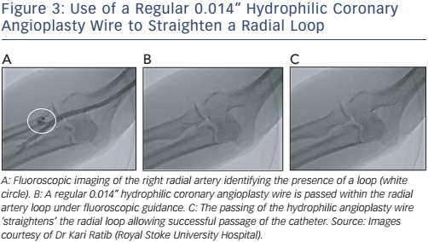
Sandhu K, Butler R, Nolan J
Figure 3: Use of a Regular 0.014” Hydrophilic Coronary Angioplasty Wire to Straighten a Radial Loop
Citation: Interventional Cardiology Review 2017;12(1):18–24
https://doi.org/10.15420/icr.2017:2:2

