Slide 1
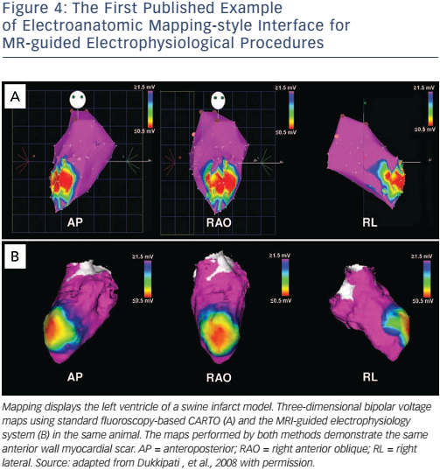
Chubb H, Williams SE, Whitaker J, Harrison JL, Razavi R, O’Neill M
Figure 4: The First Published Example of Electroanatomic Mapping-style Interface for MR-guided Electrophysiological Procedures
Citation: Arrhythmia & Electrophysiology Review 2017;6(2):85–93
https://doi.org/10.15420/aer.2017:1:2

