Slide 1
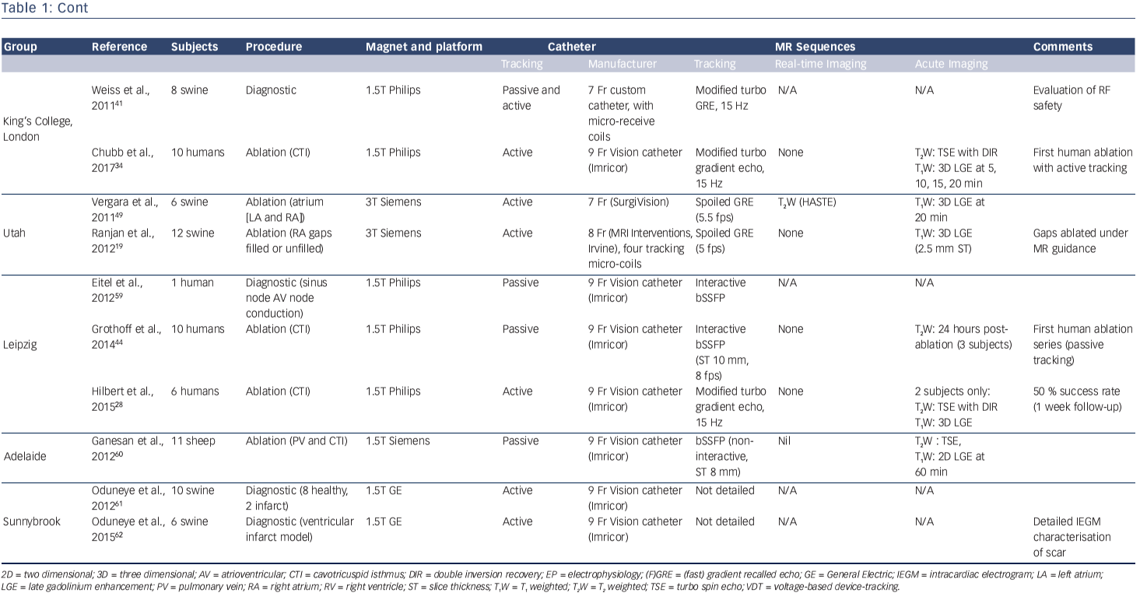
Chubb H, Williams SE, Whitaker J, Harrison JL, Razavi R, O’Neill M
Table 1: Cont
Citation: Arrhythmia & Electrophysiology Review 2017;6(2):85–93
https://doi.org/10.15420/aer.2017:1:2

