Slide 1
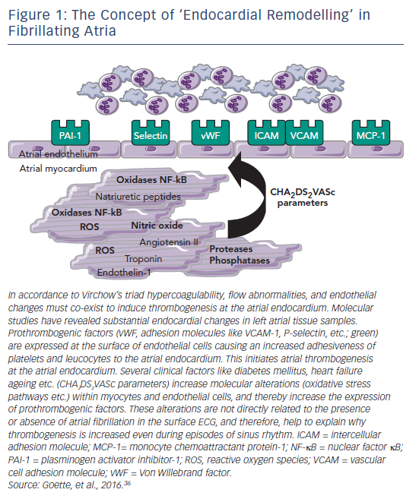
Goette A, Heidbuchel H
Figure 1: The Concept of ‘Endocardial Remodelling’ in Fibrillating Atria
Citation: Arrhythmia & Electrophysiology Review 2017;6(2):50–4.
https://doi.org/10.15420/aer.2017:3:2

