Slide 1
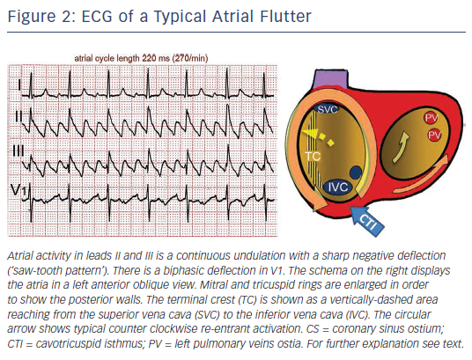
Cosio FG
Figure 2: ECG of a Typical Atrial Flutter
Citation: Arrhythmia & Electrophysiology Review 2017;6(2):55–62.
https://doi.org/10.15420/aer.2017.5.2

