Slide 1
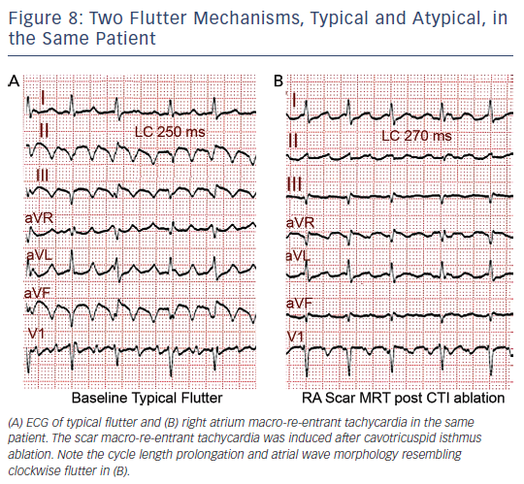
Cosio FG
Figure 8: Two Flutter Mechanisms, Typical and Atypical, in the Same Patient
Citation: Arrhythmia & Electrophysiology Review 2017;6(2):55–62.
https://doi.org/10.15420/aer.2017.5.2

