Slide 1
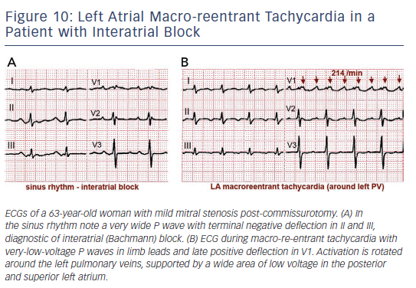
Cosio FG
Figure 10: Left Atrial Macro-reentrant Tachycardia in a Patient with Interatrial Block
Citation: Arrhythmia & Electrophysiology Review 2017;6(2):55–62.
https://doi.org/10.15420/aer.2017.5.2

