Slide 1
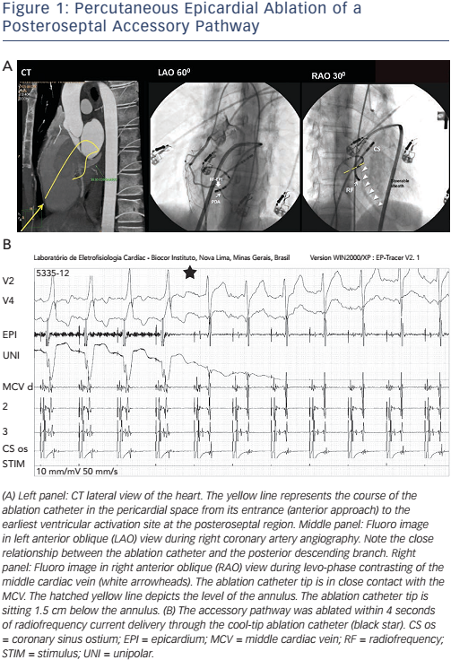
Back Sternick E, Faustino M, Soares Correa F, Pisani C, Scanavacca MI
Figure 1: Percutaneous Epicardial Ablation of a Posteroseptal Accessory Pathway
Citation: Arrhythmia & Electrophysiology Review 2017;6(2):80–4.
https://doi.org/10.15420/aer.2017:6:2

