Slide 1
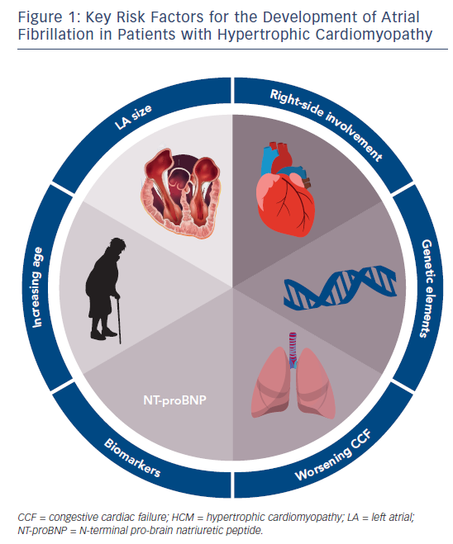
Camm CF, Camm AJ
Figure 1: Key Risk Factors for the Development of Atrial Fibrillation in Patients with Hypertrophic Cardiomyopathy
Citation: Arrhythmia & Electrophysiology Review 2017;6(2):63–8.
https://doi.org/10.15420/aer.2017:4:2

