Slide 1
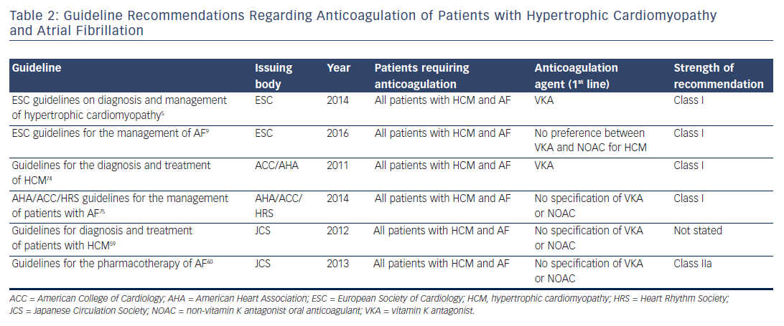
Camm CF, Camm AJ
Table 2: Guideline Recommendations Regarding Anticoagulation of Patients with Hypertrophic Cardiomyopathy and Atrial Fibrillation
Citation: Arrhythmia & Electrophysiology Review 2017;6(2):63–8.
https://doi.org/10.15420/aer.2017:4:2

