Slide 1
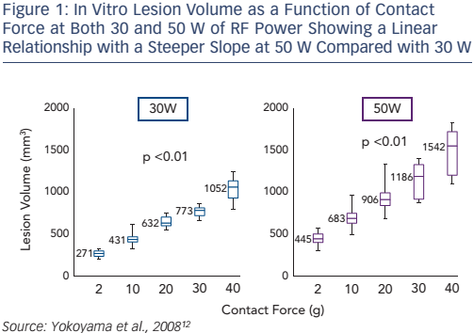
Shah D
In Vitro Lesion Volume as a Function of Contact Force at Both 30 and 50 W of RF Power Showing a Linear Relationship with a Steeper Slope at 50 W Compared with 30 W
Citation: Arrhythmia & Electrophysiology Review 2017;6(2):75–9.
https://doi.org/10.15420/aer.2017:8:2

