Slide 1
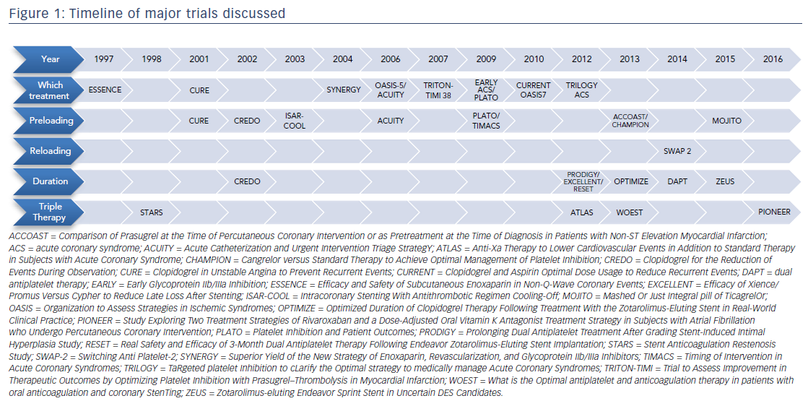
Phillips CT, Gavin MC
Figure 1: Timeline of major trials discussed
Citation: US Cardiology Review 2017;11(2):52–8.
https://doi.org/10.15420/usc.2017:8:1

