Slide 1
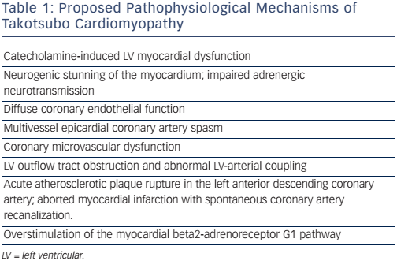
Bratis K
Table 1: Proposed Pathophysiological Mechanisms of Takotsubo Cardiomyopathy
Citation: European Cardiology Review 2017;12(1):58–62
https://doi.org/10.15420/ecr.2017:7:2

