Slide 1
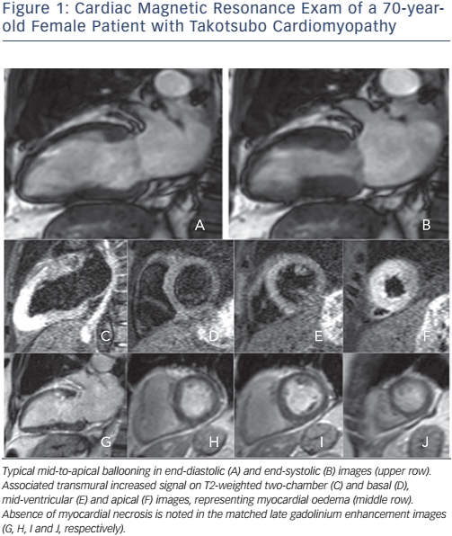
Bratis K
Figure 1: Cardiac Magnetic Resonance Exam of a 70-yearold Female Patient with Takotsubo Cardiomyopathy
Citation: European Cardiology Review 2017;12(1):58–62
https://doi.org/10.15420/ecr.2017:7:2

