Slide 1
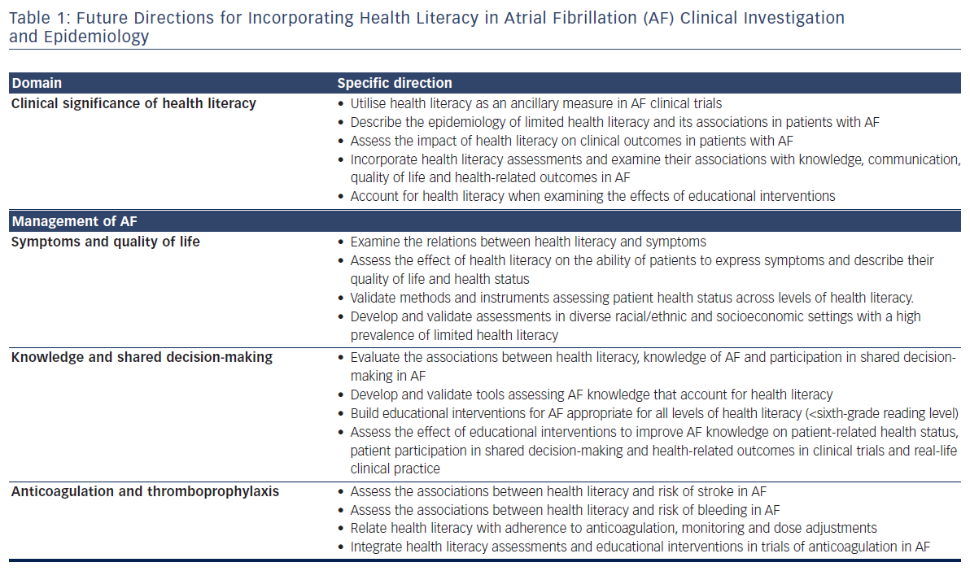
Aronis KN, Edgar B, Lin W, Parreiras Martins MA, Paasche-Orlow MK, Magnani JW
Table 1: Future Directions for Incorporating Health Literacy in Atrial Fibrillation (AF) Clinical Investigation and Epidemiology
Citation: European Cardiology Review 2017;12(1):52–7.
https://doi.org/10.15420/ecr.2017:2:2

