Slide 1
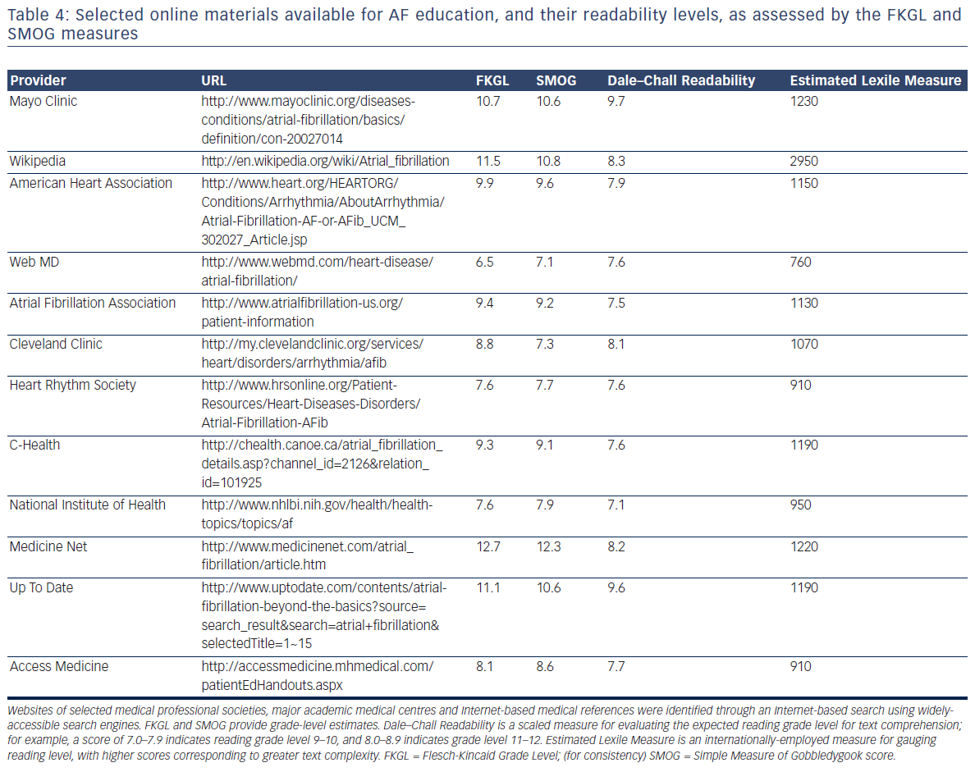
Aronis KN, Edgar B, Lin W, Parreiras Martins MA, Paasche-Orlow MK, Magnani JW
Table 4: Selected online materials available for AF education, and their readability levels, as assessed by the FKGL and SMOG measures
Citation: European Cardiology Review 2017;12(1):52–7.
https://doi.org/10.15420/ecr.2017:2:2

